Slide 1


Introduction to
Robotic Process Automation
Freelancer Income Tax Manager
2116220701522
GURUBARAN T
Dr. N.DURAI MURUGAN
PROFESSOR – DEPARTMENT OF COMPUTER SCIENCE AND ENGINEERING

Slide 2
Abstract
The Freelance Income and Tax Manager is a smart tool designed for freelancers to track income and manage taxes easily. It automates payment recording, categorizes income by source, calculates estimated taxes, and creates monthly income and tax reports. With integration to bank statements or manual input options, it offers flexibility and saves time. This bot helps freelancers stay organized, avoid errors, focus on work, and gain better financial insights, ensuring their finances are accurate and tax-ready.

Slide 3
Need for the Proposed System
Freelancers often struggle to manage their finances because of irregular income, multiple clients, and complex tax requirements. Traditional tools aren’t tailored to their needs, making it hard to track earnings and prepare for taxes. The Freelance Income and Tax Manager solves this by automating income tracking, categorizing earnings, and calculating taxes. It also provides detailed reports, helping freelancers stay organized and tax-ready. This system saves time, reduces errors, and gives freelancers more focus on their work

Slide 4
Advantages of the Proposed System
Time-Saving: Automates income tracking and tax calculations, freeing up time for freelancers to focus on their work instead of financial management.
Financial Clarity: Provides clear and detailed monthly reports, helping freelancers stay on top of their income and expenses
Tax Preparation: Ensures freelancers are ready for tax filing by calculating taxes and generating summaries tailored to their earnings
Error Reduction: Minimizes mistakes in tracking payments and calculating taxes by using automated processes

Slide 5
Literature Survey
Paper 1: "Automating Financial Processes Using Robotic Process Automation"
Overview: This paper explores the implementation of RPA in automating financial tasks such as invoice processing, expense management, and tax compliance.
Advantages:
Efficiency: Significantly reduces the time required for repetitive tasks.
Accuracy: Minimizes human errors in financial data processing.
Disadvantages:
High Setup Cost: Implementing RPA can be expensive for small-scale businesses.
Structured Data: Bots struggle with unstructured or inconsistent data inputs.
Paper 2: "Enhancing Tax Compliance Through Robotic Process Automation"
Overview:This paper highlights the role of RPA in tax compliance, focusing on automating tax calculations, report generation, and filing.
Advantages:
Regulatory Compliance: Ensures adherence to tax regulations with minimal oversight.
Cost-Effective Over Time: Saves money by reducing the need for manual tax audits and reviews.
Disadvantages:
Limited Adaptability: Changes in tax regulations require reprogramming of bots.
Potential Security Risks: Handling sensitive tax data may pose privacy and security challenges.

Slide 6
Main Objective
The Freelance Income and Tax Manager is an RPA-based solution designed to help freelancers efficiently manage their finances and taxes. It automates income tracking, categorizes earnings, calculates taxes based on local regulations, and generates monthly reports. By integrating with bank statements or allowing manual inputs, the bot ensures accurate and organized financial records, saving time and reducing errors. This tool is tailored to meet freelancers' needs, providing a streamlined approach to income and tax management.

Slide 7
System Requirements
Hardware Requirements:
Processor: Dual-Core or higher (Intel i3/i5/i7 or equivalent).
RAM: Minimum 4 GB (8 GB recommended for smooth operation).
Storage: At least 10 GB of free space.
Display: Screen resolution of 1366 x 768 or higher.
Software Requirements:
Operating System:
Windows 10 or higher (64-bit recommended).
RPA Platform:
UiPath Studio (latest stable version).
Supporting Software:
Microsoft Excel: For generating income and tax reports.
PDF Reader: To extract transaction data from bank statements.
Email Client: For sending personalized tax reminders (e.g., Outlook).
Browsers:
Google Chrome or Microsoft Edge for web integration tasks (if needed).
Dependencies:
Required libraries or packages (installable from UiPath’s Package Manager).

Slide 8
Functional Description
Income Tracking Module
Description: This module automates the tracking of income by extracting transaction details from bank statements or allowing manual entry. It categorizes income based on the source and stores all records securely for future reference.
Tax Calculation and Reporting Module
Description: This module calculates estimated taxes using local tax regulations (e.g., GST at 18%) by analyzing income, expenses, and transaction history. It generates monthly income reports and tax summaries, providing freelancers with a clear overview of their financial status

Slide 9
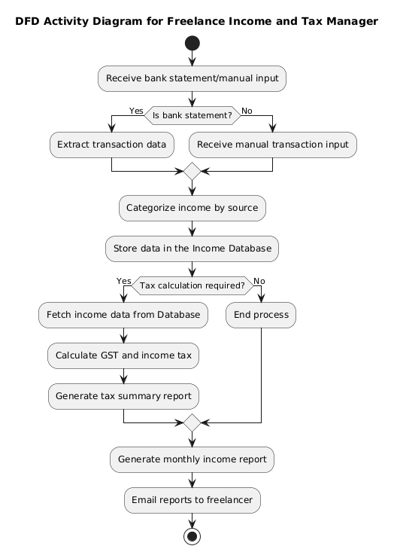
Functional Description

Slide 10
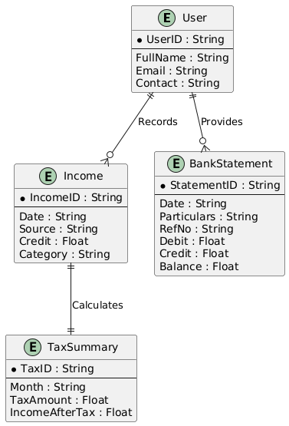
Table Design

Slide 11
Process Design
Main Process
Start Process
Trigger the bot (manually or scheduled).
Input Data Collection
Read the bank statement (Excel/CSV).
Allow manual input for additional income details if required.
Data Processing
Parse and extract transaction details (Date, Credit, Debit, Balance).
Categorize income by client or source.
Tax Calculation
Calculate estimated taxes based on credit and GST rate (18%).
Process debits for tax deductions.
Report Generation
Generate detailed monthly income and tax summaries in Excel.
Include spending trends, variances, and overall income standing.
Notification
Send personalized email reports to freelancers on a scheduled date.
End Process

Slide 12
Process Design
Sub-Processes
Read Bank Statement
Open and extract data from the provided Excel/CSV file.
Categorize Transactions
Identify income (Credit) and expenses (Debit).
Group income by client/source.
Tax Estimation
Calculate GST for income and taxes owed using formulas.
Handle deductions from debits.
Generate Report
Format extracted data into an Excel report (e.g., Monthly Overview).
Include a summary of total income, expenses, and taxes.
Send Notifications
Prepare email content with report attachments.
Send emails to users using integrated mail service.
Backdate Handling
Analyze transactions from the previous 30 days for summary reports.

Slide 13
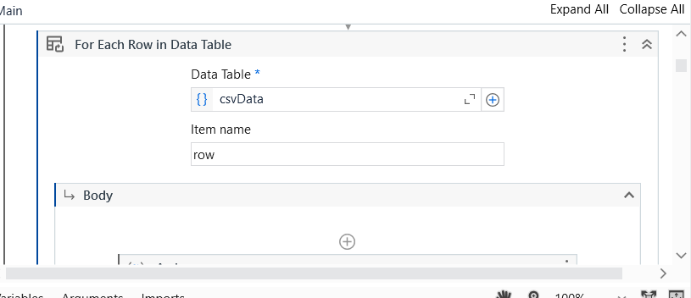
Implementation
Implementation for Income Tracking Module
This module processes bank statements or manual inputs, categorizes income, and securely stores transaction details in the database

Slide 14
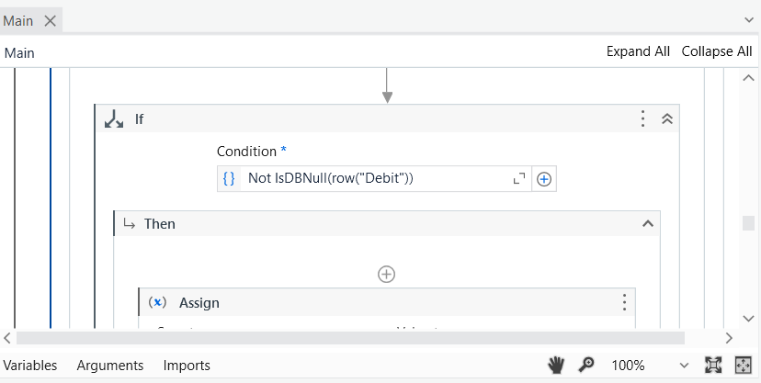
Implementation
Implementation for Tax Calculation and Reporting Module
This module fetches income data, calculates taxes, generates detailed monthly reports, and sends personalized summaries via automated emails.

Slide 15
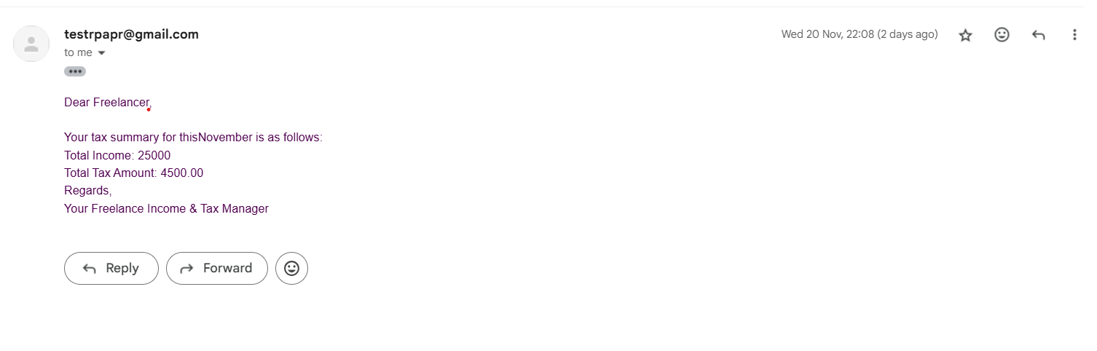
Testing
Unit Testing:
Ensured individual modules like Excel data retrieval, email triggers, and reminders work as expected.
Integration Testing:
Verified the entire process flow, from reading contract data to sending email reminders and updating the status. Screen shots

Slide 16
Conclusions
The Freelance Income and Tax Manager RPA solution offers freelancers an efficient way to manage their finances and taxes. By automating income tracking, tax calculations, and report generation, it eliminates manual errors and saves valuable time. The integration with bank statements and manual input options ensures flexibility, while the detailed tax summaries and monthly income reports keep freelancers informed and prepared for tax filing. This solution empowers freelancers to focus on their work, knowing their financials are accurately tracked and tax-ready.

Slide 17
Future Enhancement
Future enhancements for the Freelance Income and Tax Manager in RPA could include integrating more advanced tax calculation features, such as support for multiple tax regimes (e.g., income tax slabs, deductions, and exemptions). Additionally, the bot could be enhanced to automatically sync with multiple bank accounts or payment gateways, providing a real-time update on income. The inclusion of machine learning could help predict income trends and suggest tax-saving strategies based on historical data. Furthermore, integrating with government tax filing systems for direct submission of tax returns could streamline the entire tax management process, making it even more efficient and user-friendly.

Slide 18
References
Journals
Johnston, P., & Davis, R. (2018). "Exploring the Role of Robotic Process Automation in Business Operations." International Journal of Business Automation, 15(4), 210-220.
Sullivan, A., & White, G. (2020). "RPA: Transforming Business Efficiency." Journal of Digital Transformation, 22(1), 45-56.
Miller, T. (2019). "The Impact of Automation on Contract Management." Automation in Legal Tech Journal, 8(3), 112-125.
Williams, K., & Turner, M. (2021). "Intelligent Automation in Contract Lifecycle Management." International Journal of Legal Technology, 10(2), 78-90.

Slide 19
Queries

Slide 20
Demonstration

Slide 21
Thank You

